Slide 1

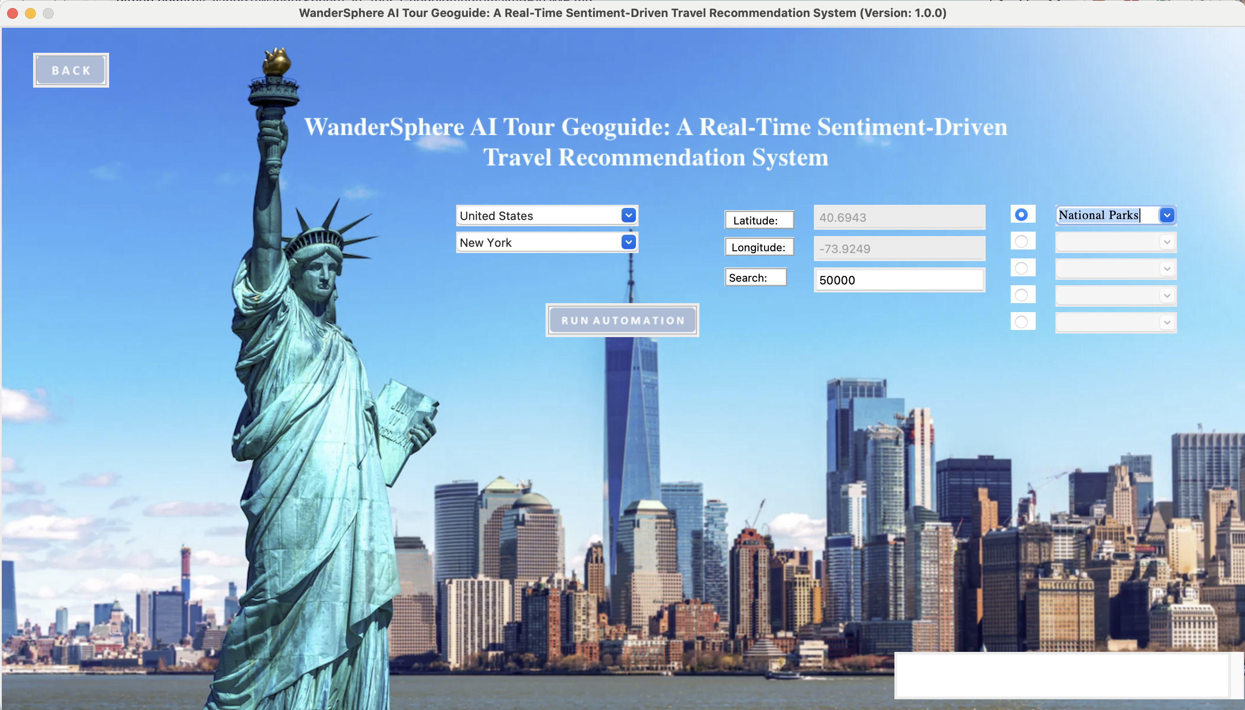

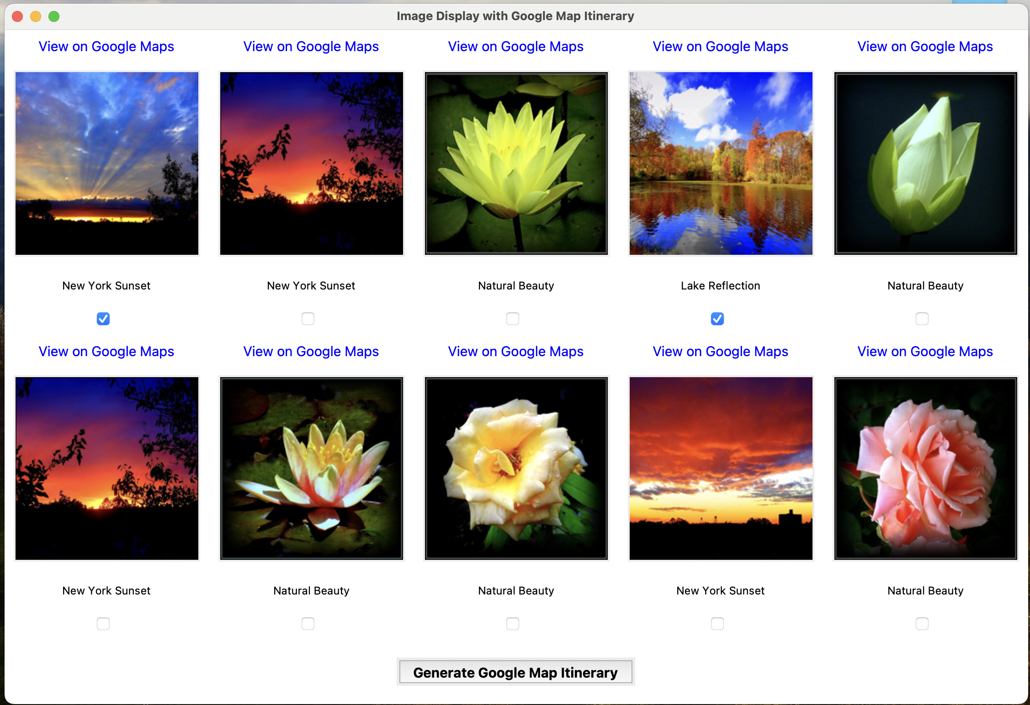
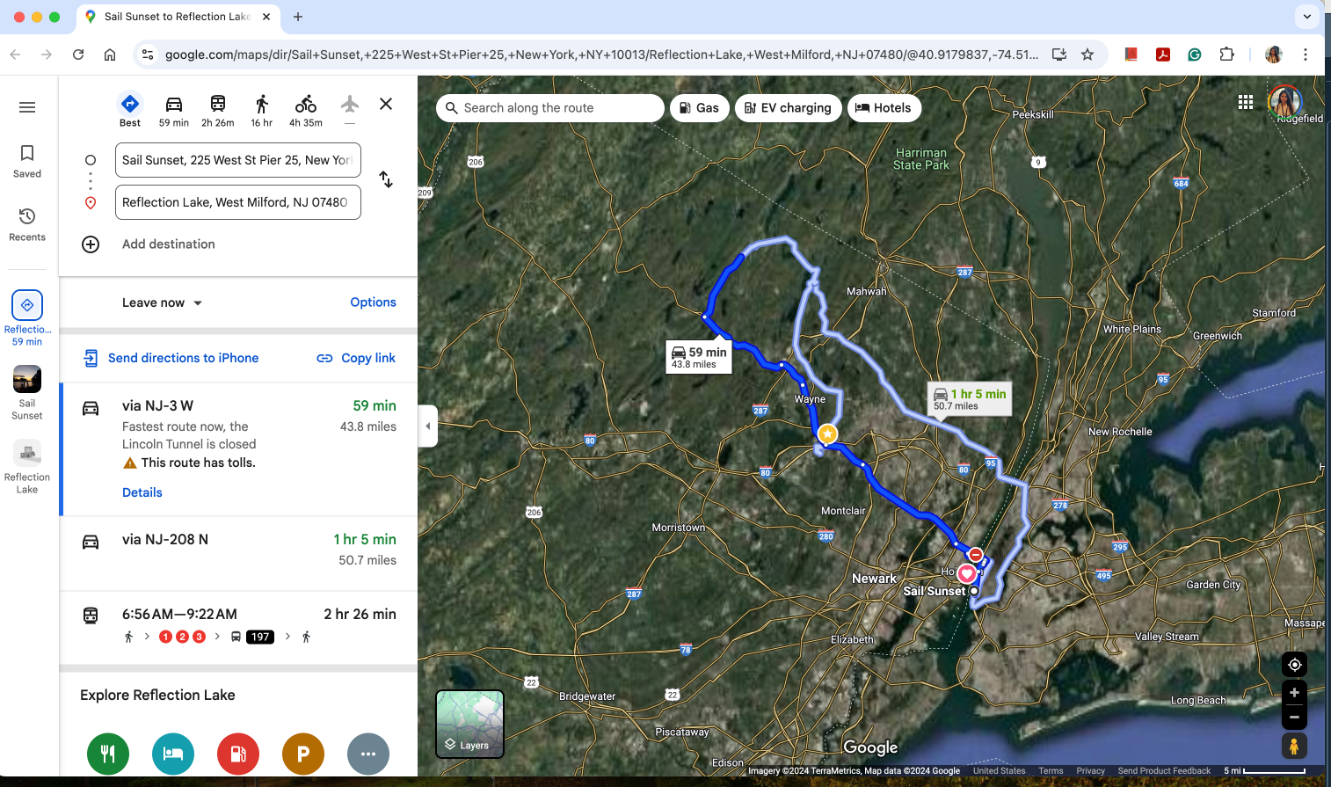
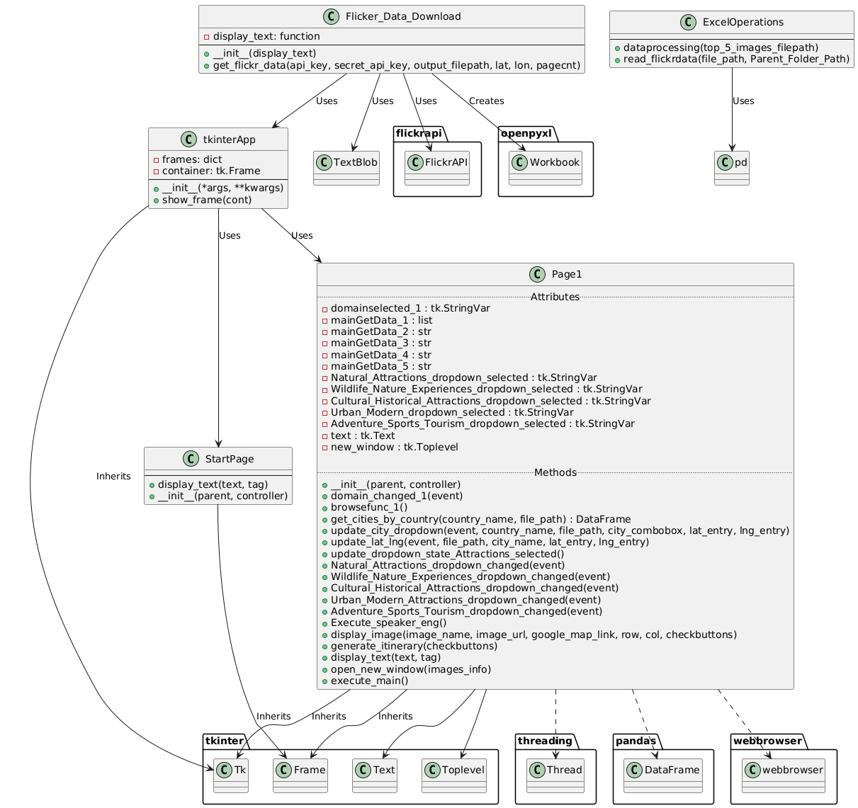
WanderSphere AI Tour Geoguide: A Real-Time Sentiment-Driven Travel Recommendation System
Komal Wavhal, Qijun Jiang, Hemanth Bathini
Department of Electrical and Computer Engineering
Introduction
WanderSphere is an innovative AI-powered tour guide designed to recommend personalized travel destinations and experiences in real-time based on the sentiment analysis of user feedback, reviews, and social media data. The system requires user to give the county and city wish to go and will give basic information and pictures of 10 popular places by Flickr API. The sentimental analysis is used for comments to get an idea which places are having better comments and should be suggested to the user. After this, the user can choose the places willing to find them in Google map to make a travel plan for himself/herself.
Software Overview
Materials and Methods
- Python Flickr API​
- Tkinter Library ​
- TextBlob​
- webbrowser ​
- Pandas​
- threading module in python
- Pillow
List of Major Features
User can choose the wanted Country and City
User will be provided with 10 popular places with corresponding name, image, and link to Google Map
User will be able to choose multiple places at the same time and display them in Google Map at the same time
Future Development
Surrounding hotels, restaurants
Area info comparison between the top 10 popular places
Supports more languages for users from different countries
Voice inputs in user input parts (Accessibility support)
Acknowledgements
Advised by Professor Joseph Helsing

